Slide 1


Anas ALWohaib
2024/06/18

Slide 2

Outline
Executive Summary
Introduction
Methodology
Results
Conclusion
Appendix

Slide 3
Executive Summary
Summary of methodologies
Data Collection
Data wrangling
EDA with data visualization
EDA with SQL
Interactive map with folium
Dashboard with Plotly Dash
Predictive analysis - Classification
Summary of all results
Exploratory data analysis results
○ Interactive analytics demo in screenshots
○ Predictive analysis results

Slide 4
Introduction
Project background and context
The era of commercial space has arrived, and there are several companies that are making
space travel affordable for everyone. Perhaps the most successful of them is SpaceX, and one of
the reasons is that their rocket launch is relatively inexpensive.
SpaceX advertises Falcon 9 rocket launches on its website, with a cost of 62 million dollars;
other providers cost upward of 165 million dollars each, much of the savings is because SpaceX
can reuse the first stage.
Therefore, we will predict if the Falcon 9 first stage will land successfully. If we can determine
if the first stage will land, we can determine the cost of a launch. This information can be used if an alternate company wants to bid against SpaceX for a rocket launch
Problems you want to find answers
Correlations between each rocket variables and successful landing rate
Conditions to get the best results and ensure the best successful landing rate

Slide 5

Section 1

Slide 6
Methodology
Executive Summary
Data collection methodology:
Using Web-Scraping and API
Perform data wrangling
Convert outcomes into labels describing the status of landing
Perform exploratory data analysis (EDA) using visualization and SQL
Perform interactive visual analytics using Folium and Plotly Dash
Perform predictive analysis using classification models
Finding the best parameter for predictive models ( SVM - Classifications models ... )

Slide 7
Data Collection
Describe how data sets were collected.
Datasets were collected from web-Scraping through these processes
HTML response > Extract data using Beuatifoul soup > Normalize data to CSV file
Also datasets collected from API through this process
Request data from the API > Return JSON file > Normalize data to CSV file

Slide 8
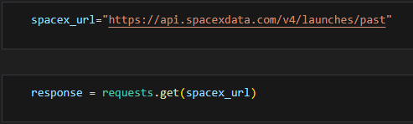
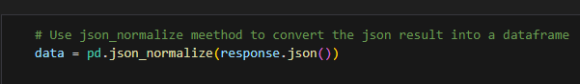
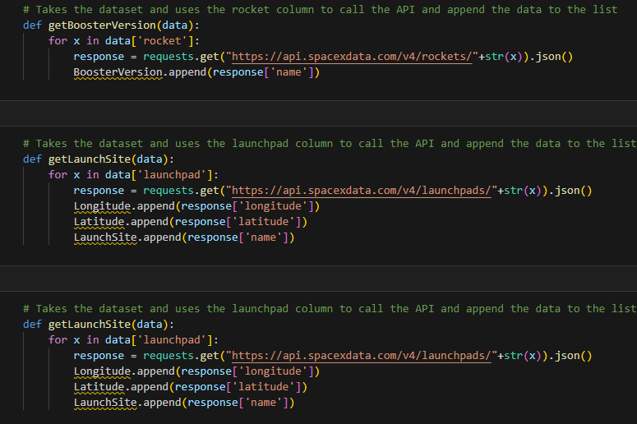
Data Collection – SpaceX API
Requesting Data using API
To JSON File
Applying Functions to clean data
GitHub Link

Slide 9
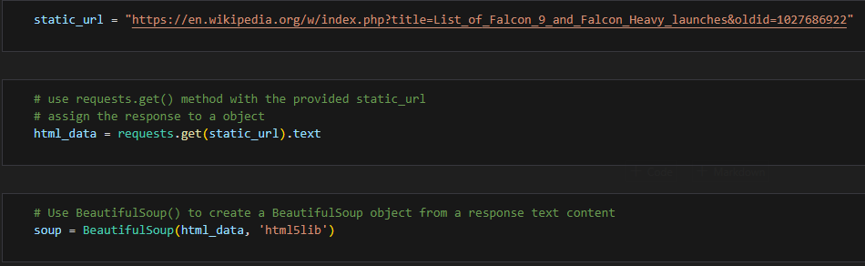
Data Collection - Scraping
Requesting data from URL
Get the data
Using beautifulsoup
Github Link
Place your flowchart of web scraping here

Slide 10
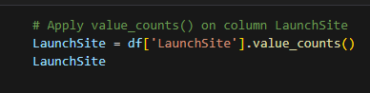
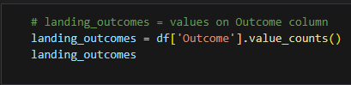
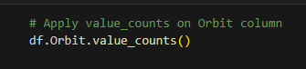
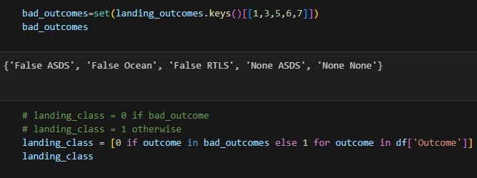
Data Wrangling
Calculating the numbers of each column needed
Create landing outcome labels depending on Outcome column
Github Link

Slide 11
EDA with Data Visualization
• Scatter chart:
○ Flight Number vs. Launch Site
○ Payload vs. Launch Site
○ Flight Number vs. Orbit Type
○ Payload vs. Orbit Type
A scatter plot shows how much one variable is affected by another. The relationship between two variables is called a correlation. This plot is generally composed of large data bodies.
• Bar chart:
○ Orbit Type vs. Success Rate
A Bar chart makes it easy to compare datasets between multiple groups at a glance. One axis represents a category and the other axis represents a discrete value. The purpose of this chart is to indicate the relationship between the two axes.
• Line chart:
Year vs. Success Rate
A Line chart shows data variables and trends very clearly and helps predict the results of data that has not yet been recorded.
GitHub Link

Slide 12
EDA with SQL
• Loading the dataset into the corresponding table in a Db2 database, and executing SQL queries to answer following questions:
○ Displaying the names of the unique launch sites in the space mission
Displaying 5 records where launch sites begin with the string 'CCA'
Displaying the total payload mass carried by boosters launched by NASA (CRS)
Displaying average payload mass carried by booster version F9 v1.1
Listing the date when the first successful landing outcome in ground pad was achieved
Listing the names of the boosters which have success in drone ship and have payload mass greater than 4000 but less than 6000
Listing the total number of successful and failure mission outcomes
Listing the names of the booster_versions which have carried the maximum payload mass
Listing the failed landing_outcomes in drone ship, their booster versions, and launch site names for in year 2015
Ranking the count of landing outcomes (such as Failure (drone ship) or Success (ground pad)) between the date 2010-06-04 and 2017-03-20, in descending order
Github Link

Slide 13
Build an Interactive Map with Folium
Objects created and added to a folium map:
Markers that show all launch sites on a map
Markers that show the success/failed launches for each site on the map
Lines that show the distances between a launch site to its proximities
• By adding these objects, following geographical patterns about launch sites are found:
Are launch sites in close proximity to railways? Yes
Are launch sites in close proximity to highways? Yes
Are launch sites in close proximity to coastline? Yes
Do launch sites keep certain distance away from cities? Yes
Github Link

Slide 14
Build a Dashboard with Plotly Dash
The dashboard application contains a pie chart and a scatter point chart.
Pie chart
For showing total success launches by sites
This chart can be selected to indicate a successful landing distribution across all launch sites or to indicate the success rate of individual launch sites.
Scatter chart
For showing the relationship between Outcomes and Payload mass (Kg) by different boosters
Has 2 inputs: All sites/individual site & Payload mass on a slider between 0 and 10000 kg
This chart helps determine how success depends on the launch point, payload mass, and booster version categories.
Github Link

Slide 15
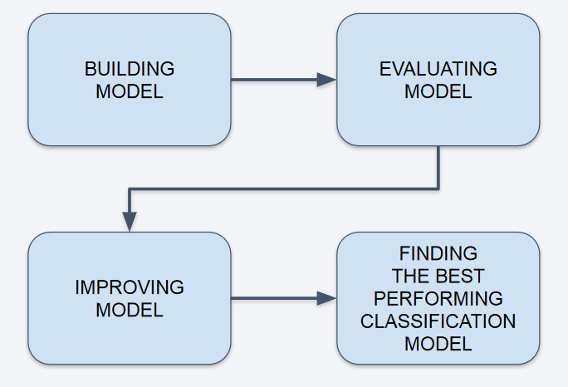
Predictive Analysis (Classification)
• Perform exploratory Data Analysis
and determine Training Labels
○ Create a column for the class
○ Standardize the data
○ Split into training data and test
data
• Find best Hyperparameter for SVM,
Classification Trees and Logistic
Regression
○ Find the method performs best
using test data

Slide 16
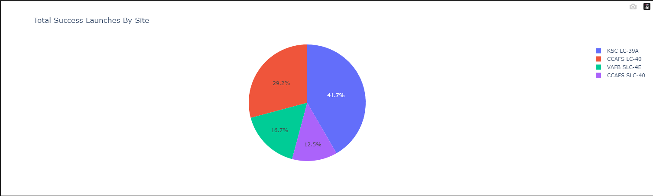
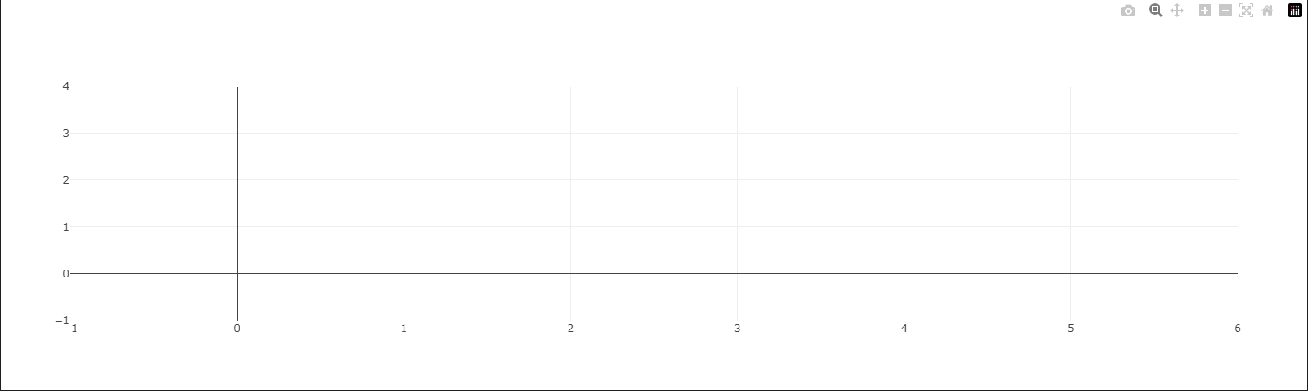
Results
The left screenshot is a preview of the Dashboardwith Plotly Dash.
The results of EDA with nvisualization, EDA with SQL, Interactive Map with Folium, and Interactive Dashboardwill be shown in the next slides.
Comparing the accuracy of the four methods, all returnthe same accuracy of about 83% for test data.
Github Link

Slide 17

Section 2

Slide 18
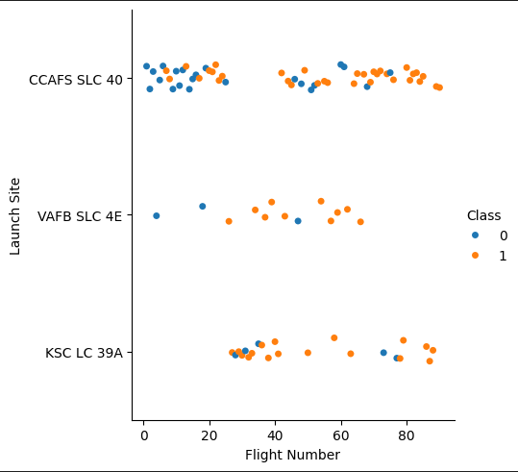
Flight Number vs. Launch Site
Class 0 (blue) represents unsuccessful launch, and Class 1
(orange) represents successful launch.
This figure shows that the success rate increased as the number of flights increased.
As the success rate has increased considerably since the 20th flight, this point seems to be a big breakthrough.
Github Link

Slide 19
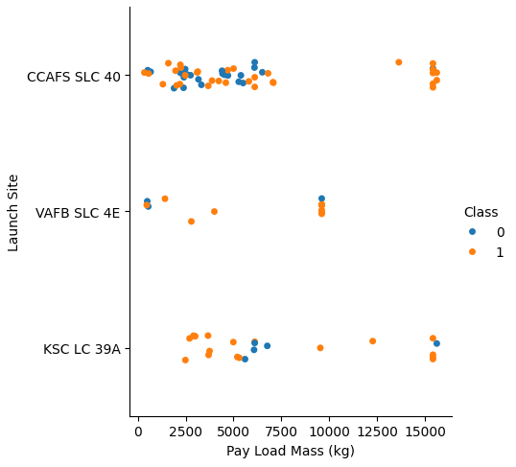
Payload vs. Launch Site
At first glance, the larger pay load mass, the higher the rocket's success rate, but it seems difficult to make decisions based on this figure because no clear pattern can be found between successful launch and Pay Load Mass.
Github Link

Slide 20
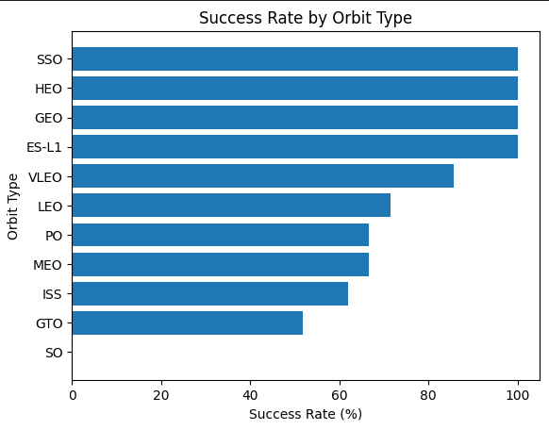
Success Rate vs. Orbit Type
Orbit types SSO, HEO, GEO, and ES-L1 have the highest success rates (100%).
• On the other hand, the success rate of orbit type GTO is only 50%, and it is the lowest except for type SO, which recorded failure in a single attempt.
Github Link

Slide 21
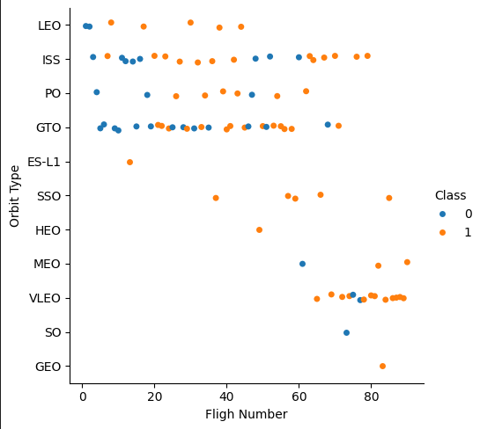
Flight Number vs. Orbit Type
In most cases, the launch outcome seems to be correlated with the flight number.
• On the other hand, in GTO orbit, there seems to be no relationship between flight numbers and success rate.
• SpaceX starts with LEO with a moderate success rate, and it seems that VLEO, which has a high success rate, is used the most in recent launches.
GitHub Link

Slide 22
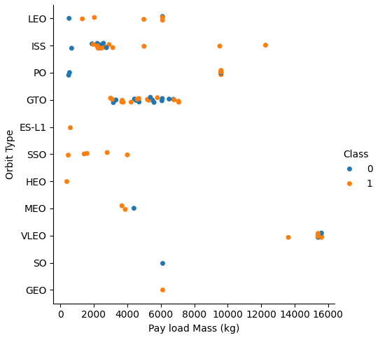
Payload vs. Orbit Type
• With heavy payloads the successful landing or positive landing rate are more for LEO and ISS.
• However, in the case of GTO, it is hard to distinguish between the positive landing rate and the negative landing because they are all gathered together.
Github Link

Slide 23
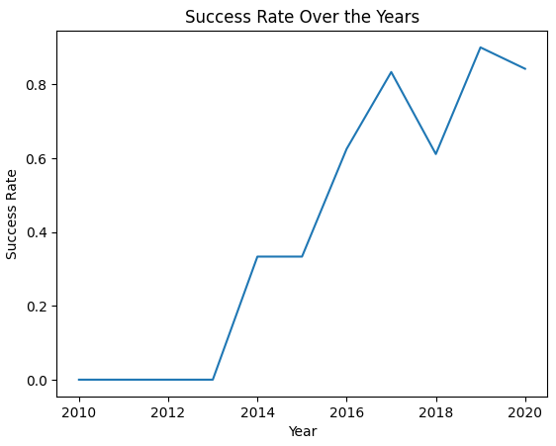
Launch Success Yearly Trend
• Since 2013, the success rate has continued to increase until 2017.
• The rate decreased slightly in 2018.
• Recently, it has shown a success rate of about 80%.
Github Link

Slide 24
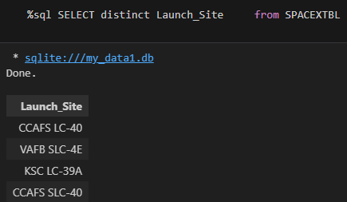
All Launch Site Names
When the SQL DISTINCT clause is used in the query, only unique values are displayed in the Launch_Site column from the SpaceX table.
• There are four unique launch sites:
CCAFS LC-40, CCAFS SLC-40,
KSC LC-39A, VAFB SLC-4E

Slide 25
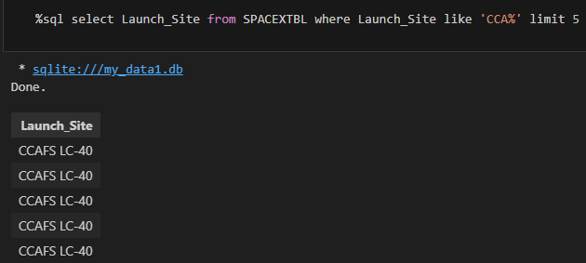
Launch Site Names Begin with 'CCA'
Only five records of the SpaceXtable were displayed using LIMIT 5 clause in the query.
• Using the LIKE operator and the percent sign (%) together, the Launch_Site name starting withCAA could be called.

Slide 26
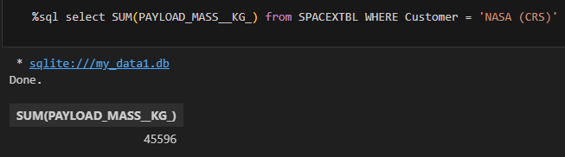
Total Payload Mass
Using the SUM() function to calculate the sum of column PAYLOAD_MASS__KG_.
In the WHERE clause, filter the dataset to perform calculations only if Customer is NASA (CRS).

Slide 27
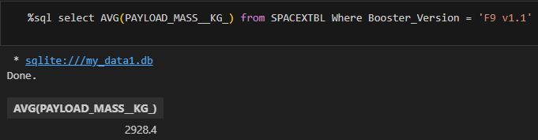
Average Payload Mass by F9 v1.1
• Using the AVG() function to calculate the average value of column PAYLOAD_MASS__KG_.
• In the WHERE clause, filter thedataset to perform calculations only if Booster_version is F9 v1.1.

Slide 28
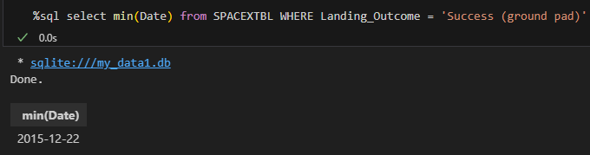
First Successful Ground Landing Date
• Using the MIN() function to find out the earliest date in the column DATE.
• In the WHERE clause, filter the dataset to perform a search only if Landing__outcome is Success (ground pad).

Slide 29
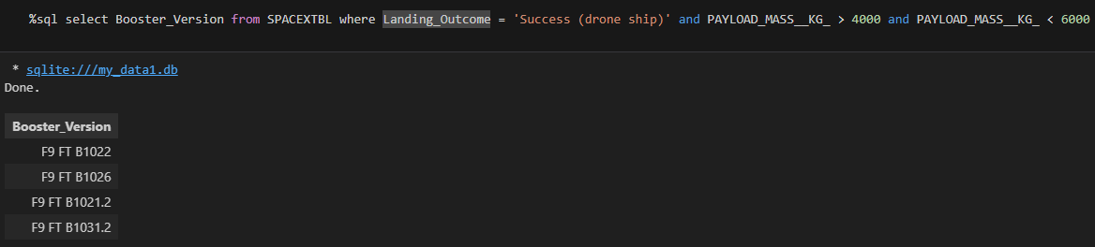
Successful Drone Ship Landing with Payload between 4000 and 6000
• In the WHERE clause, filter the dataset to perform a
search if Landing__outcome is Success (drone
ship).
Using the AND operator to display a record if
additional condition PAYLOAD_MASS__KG_ is between 4000 and 6000.

Slide 30
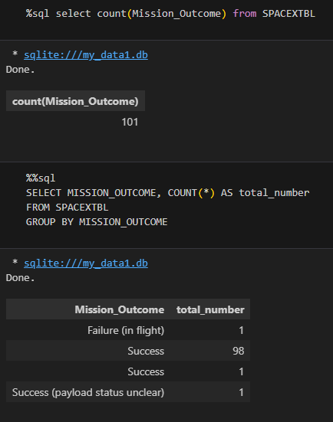
Total Number of Successful and Failure Mission Outcomes
• Using the COUNT() function to calculate the total number of columns.
• Using the GROUP BY statement, groups rows that have the same values into summary rows to find the total number in each Mission_outcome.
• According to the result, SpaceX seems to have successfully completed nearly 99% of its missions.

Slide 31
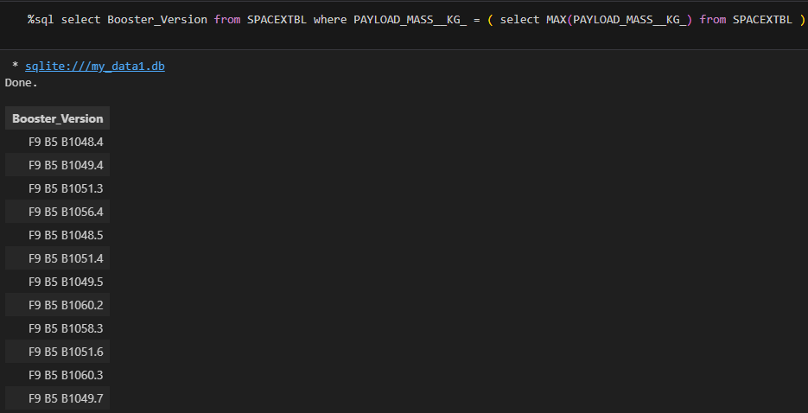
Boosters Carried Maximum Payload
• Using a subquery, first, find the maximum value of the payload by using MAX() function, and second, filter the dataset to perform a search if PAYLOAD_MASS__KG_ is the maximum value of the payload.
• According to the result, version F9 B5 B10xx.x
boosters could carried the maximum payload.

Slide 32
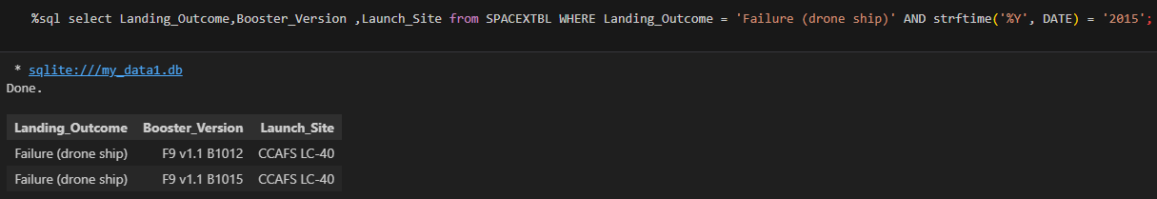
2015 Launch Records
• In the WHERE clause, filter the dataset to perform a search if Landing__outcome is Failure (drone ship).
○ Using the AND operator to display a record if additional condition YEAR is
2015.
• In 2015, there were two landing failures on drone ships.

Slide 33
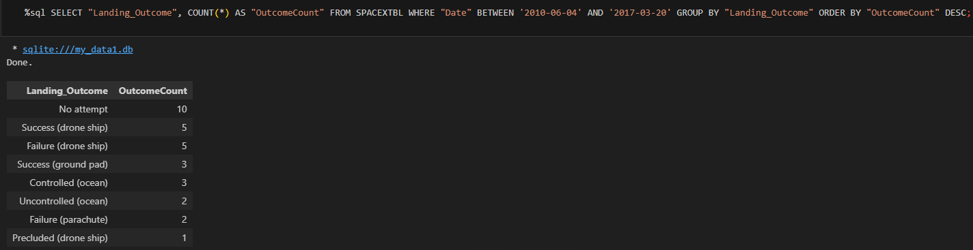
Rank Landing Outcomes Between 2010-06-04 and 2017-03-20
• In the WHERE clause, filter the dataset to perform a search if the date is between 2010-06-04 and 2017-03-20.
• Using the ORDER BY keyword to sort the records by total number of landing, and using DESC keyword to sort the
records in descending order.
• According to the results, the number of successes and failures between 2010-06-04 and 2017-03-20 was similar

Slide 34

Section 3

Slide 35
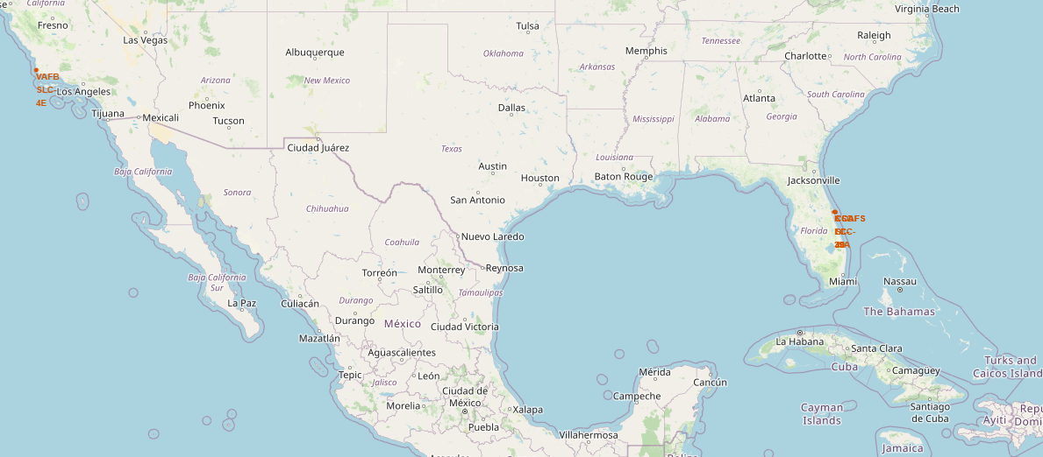
All Launch Sites Locations
• As can be seen on the map, all launch sites are
near the coast.

Slide 36
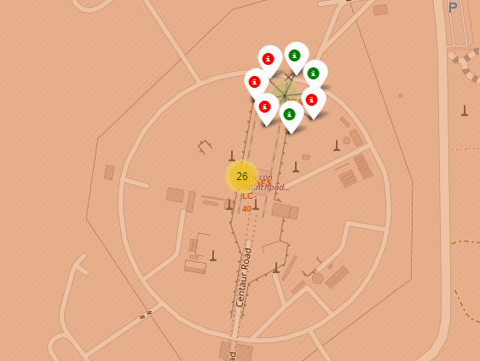
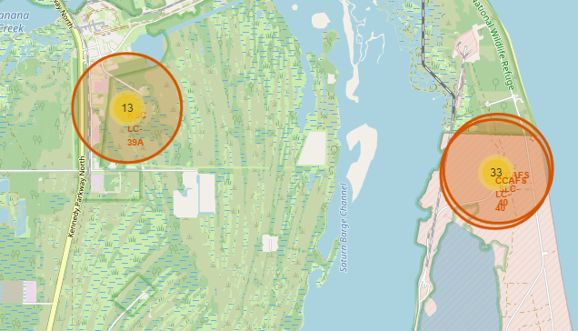
Color-labeled Launch Outcomes
By clicking on the markerclusters, successful landing (green) or failed landing (red) are displayed.

Slide 37
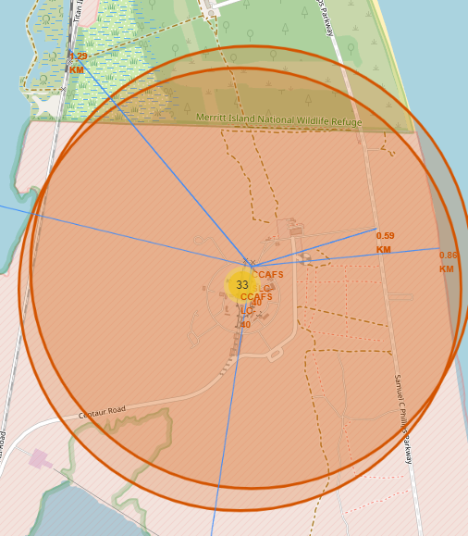
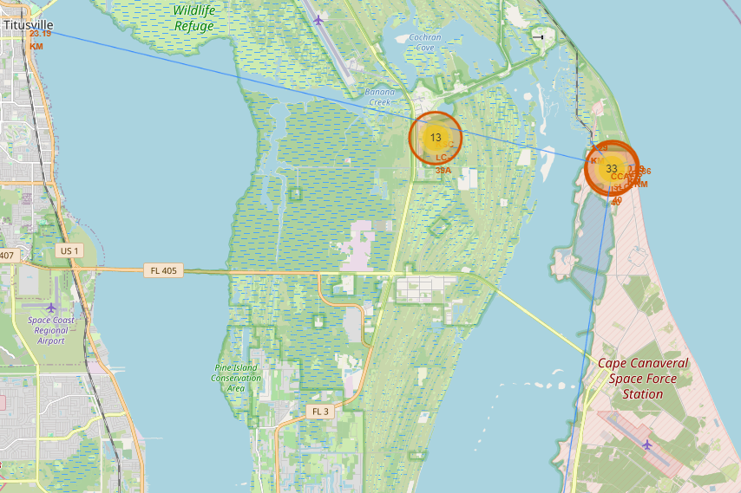
Proximities of Launch Sites
• It can be found that the launch site is close to railways and highways for transportation of equipment or personnel,
and is also close to coastline and relatively far from the cities so that launch failure does not pose a threat.

Slide 38

Section 4

Slide 39
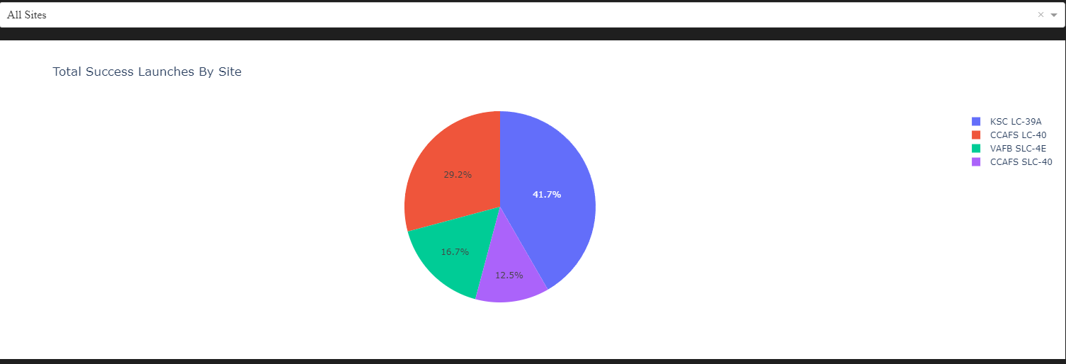
Pie Chart - Total success launches
We can find here piechart descriping successful launching for KSC LC-39A,CCAFS LC-40, VAFB SLC-4E, CCAFS SLC-40

Slide 40
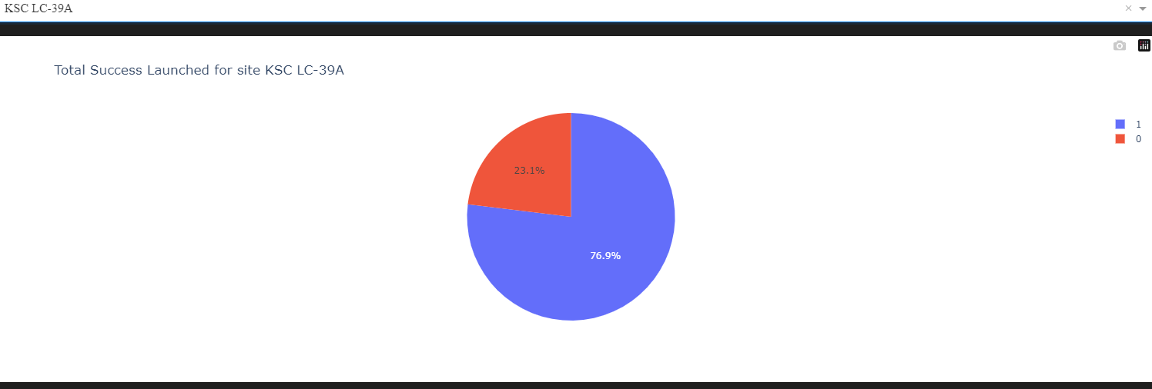
Highest launch ration
KSLC-39A has the highest success rate with 10 landing successes (76.9%)
and 3 landing failures (23.1%).

Slide 41
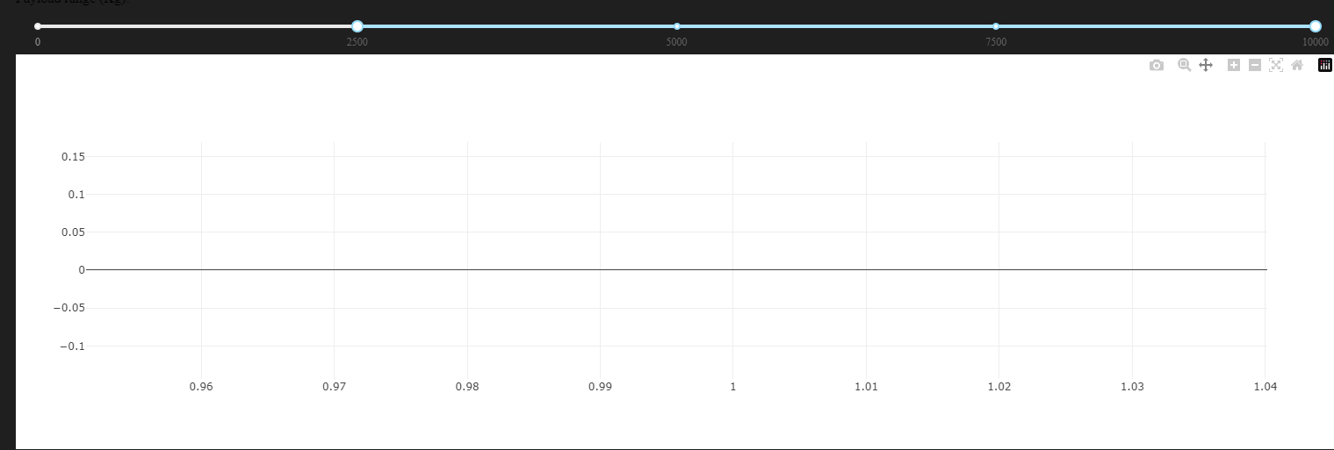

Slide 42

Section 5

Slide 43
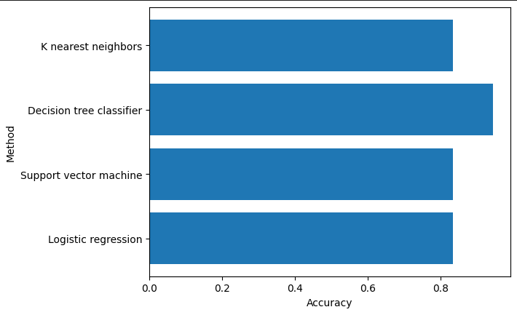
Classification Accuracy
We can find here in the barchart the accuracy of each model.
We can notice that Descision Tree has the best accuracy ~ 0.9%
We can also notice that the other models having same accuracy rate 0.8%

Slide 44
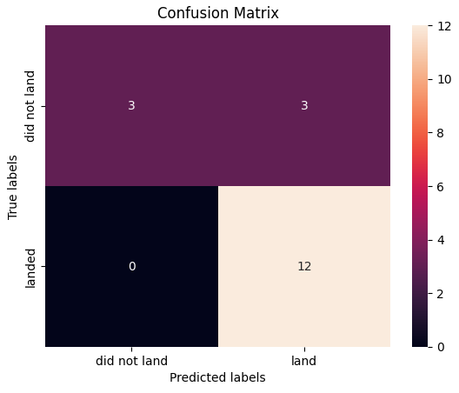
Confusion Matrix
• The confusion matrix is the same for all
models because all models performed the same for the test set.
• The models predicted 12 successful landings when the true label was successful and 3 failed landings when the true label was failure. But there nwere also 3 predictions that said successful landings when the true label was failure (false positive).
• Overall, these models predict successful landings.

Slide 45
Conclusions
• As the number of flights increased, the success rate increased, and recently it
has exceeded 80%.
• Orbital types SSO, HEO, GEO, and ES-L1 have the highest success rate (100%).
• The launch site is close to railways, highways, and coastline, but far from cities.
• KSLC-39A has the highest number of launch successes and the highest success
rate among all sites.
• The launch success rate of low weighted payloads is higher than that of heavy
weighted payloads.
• In this dataset, all models have the same accuracy (83.33%) except tree model, but it seems that more data is needed to determine the optimal model due to the small data size.

Slide 46
Appendix
GitHub Link
IBM Data Science professional certificate Capastone

Slide 47


